Slide 1

Structured Query Language for Data Management
7
Relationship
9
ADVANCED
5
FROM
How to create…
Backup database
Using cursors
Temporary tables
Variables….
1
DATABASE
3
WHERE
Joining Tables
Using Aliases …
What is a database
What is SQL
How to install SQL Server …
Basics of WHERE
Logical Operations
Using literals
Using Wildcards…
8
INSERT & DELETE
10
WHAT IS NEXT?
Inserting data
Deleting data
Truncate a table..
Where to get help
SQL interview quests
4
GROUP BY & HAVING
6
CREATE & DROP TABLE
Basics of Summarizing
Aggregate functions
Filtering aggregates …
Primary and foreign keys…
2
SELECT & ORDER BY
Basics of SELECT
Math operations
CASE and IIF
*…
Biz Nigatu
Software Engineer and Instructor
reckonedforce.com
@bizNigatu

Slide 2
Section 1 – Database and MS SQL Server Basics
What is a database?
How to Installing MS SQL Server?
What a SQL Server Management Studio (SSMS) environment looks like?
Important Shortcuts in SSMS
How to create a database?
How to create the course sample database (CIA FactBook DB)?
How to use drag and drop functionality of SSMS?
How to select a table without writing a query?
How to change a database context?
How/ Why comments in SQL?

Slide 3
What is a Database?
A database is an organized collection of data used for the purpose of modeling some type of organization or organizational process (Hernandez, 2013).
It really doesn’t matter whether you’re using paper or an application program to collect and store the data. You have a database as long as you’re collecting and storing data in some organized manner for a specific purpose.

Slide 4
What is a Database? Cont.…
Database Management System also called the DBMS is a software that manages a database management systems have many advantages a DBMS is a general-purpose logic that is reusable across applications. This logic is made available via the SQL language.

Slide 5
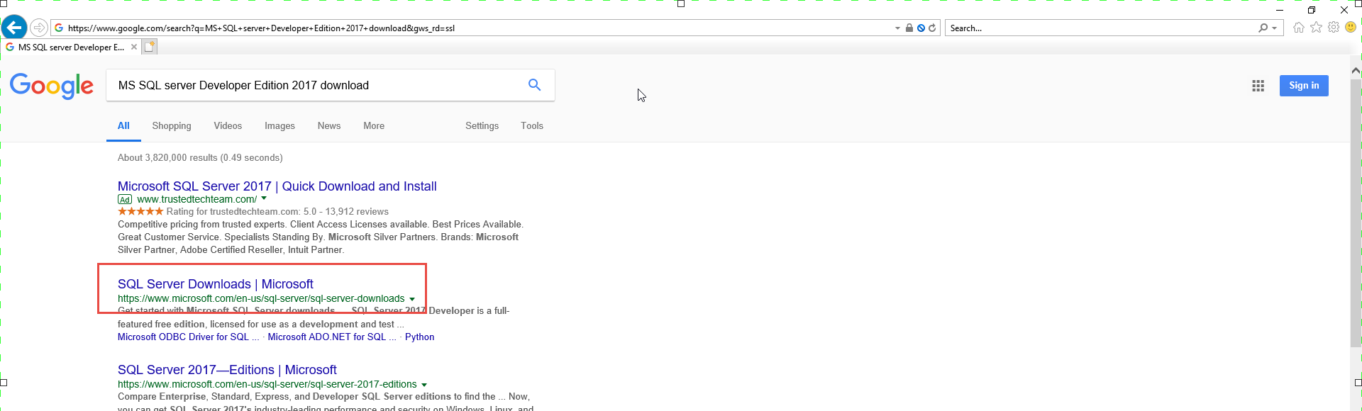

How to Install MS SQL Server Basics
Go to your favorite search engine type “MS SQL server Developer Edition 2017 download”

Slide 6
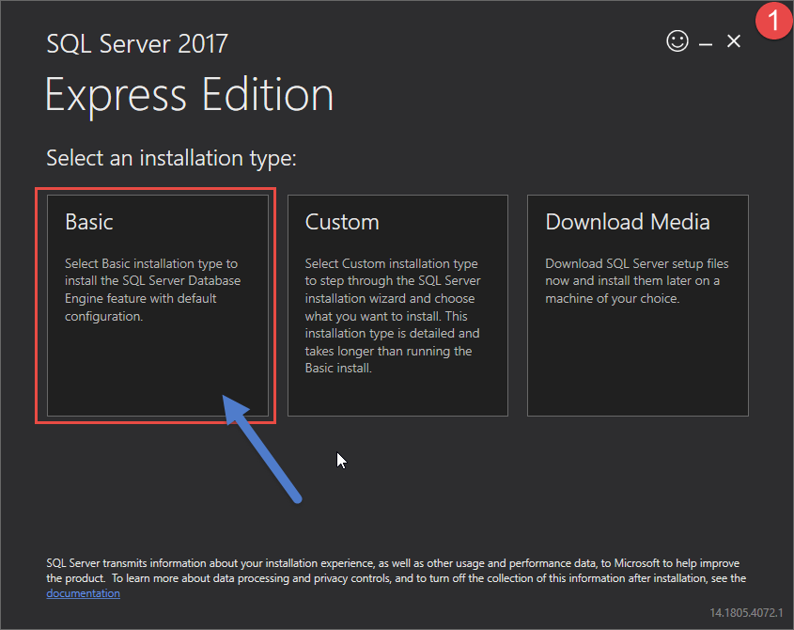
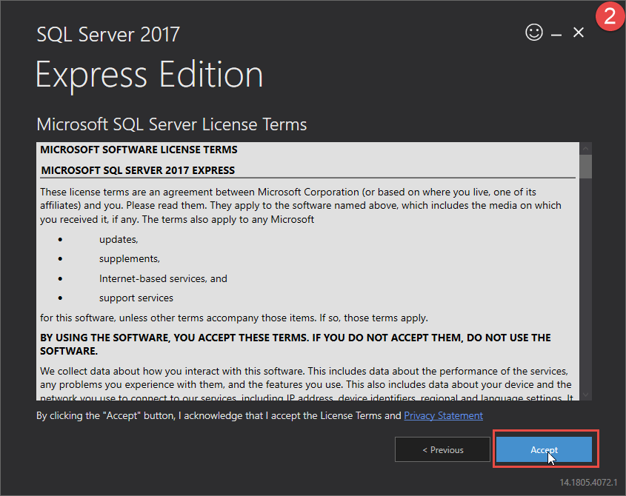
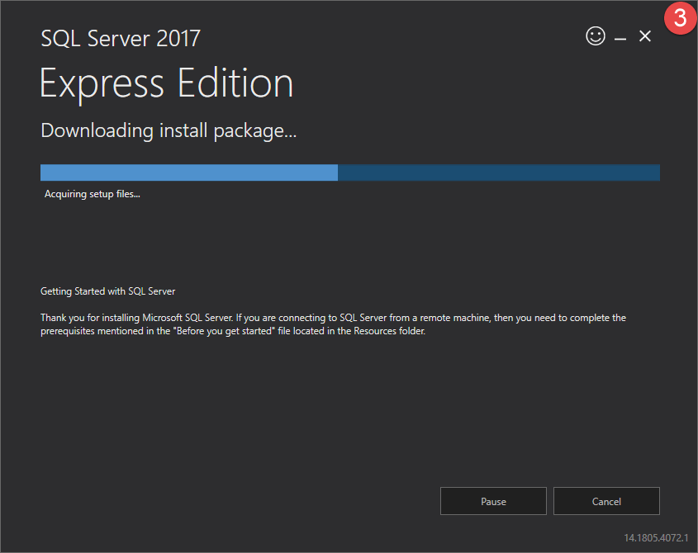

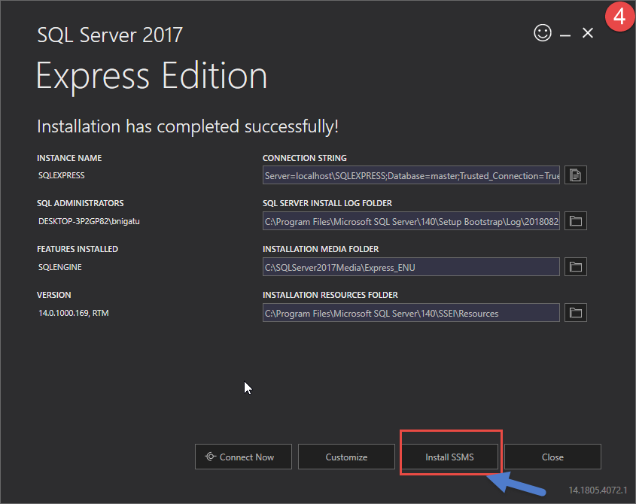
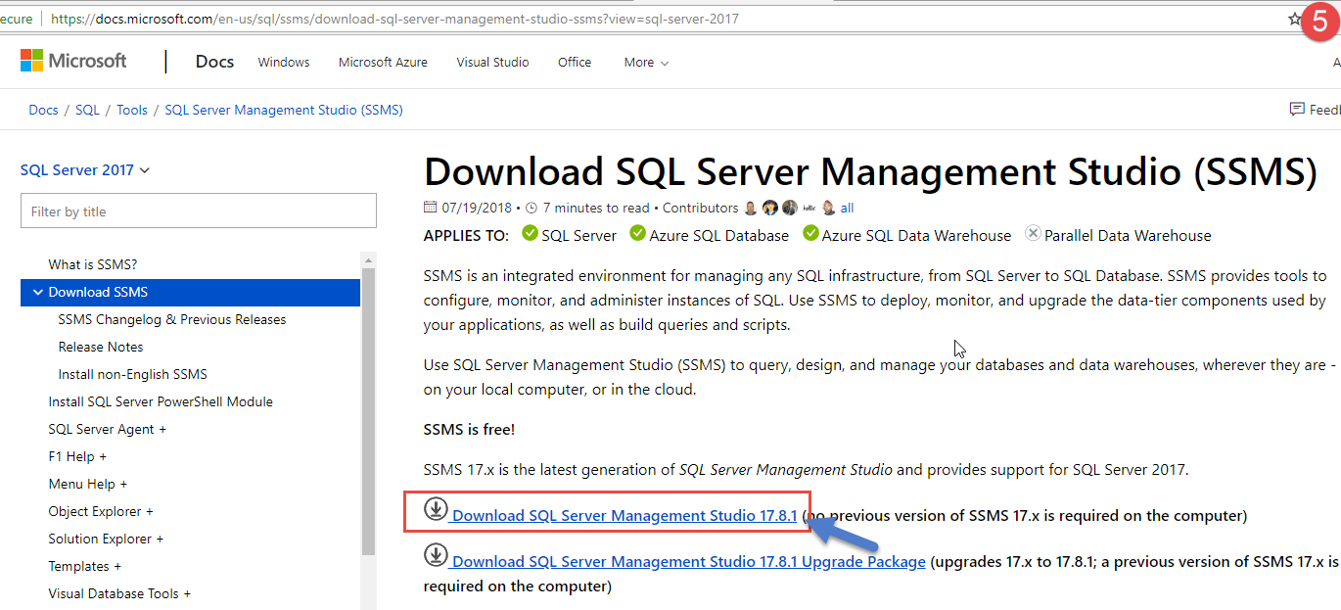
How to Install MS SQL Server Cont…and How to Install SSMS
Follow the on screen guide to install MS SQL Server Developer Edition.

Slide 7
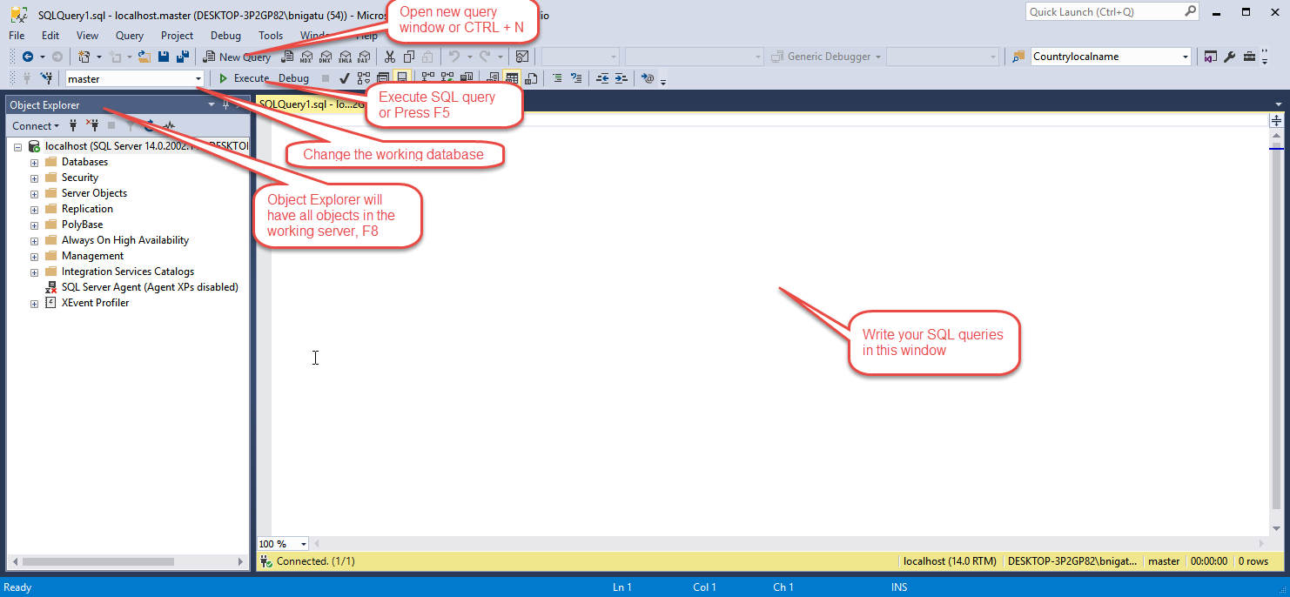
MS SQL Server Management Studio Environment

Slide 8
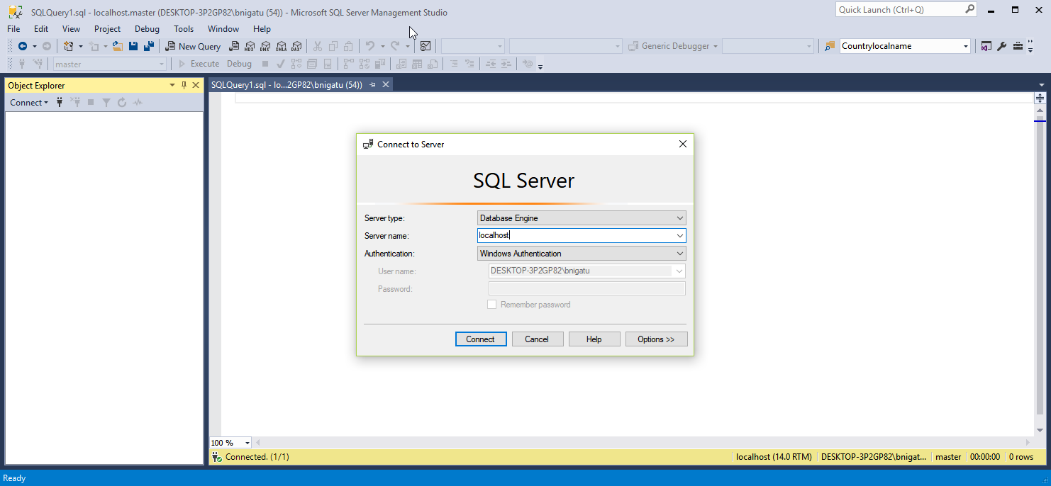
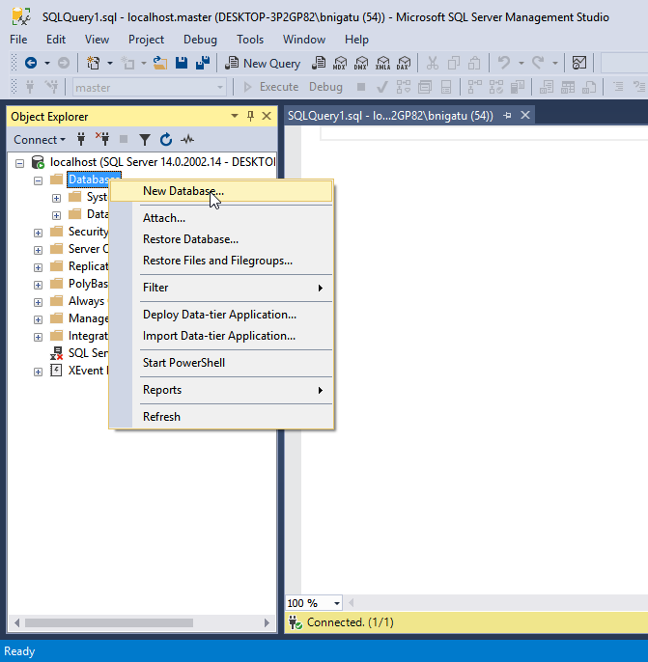
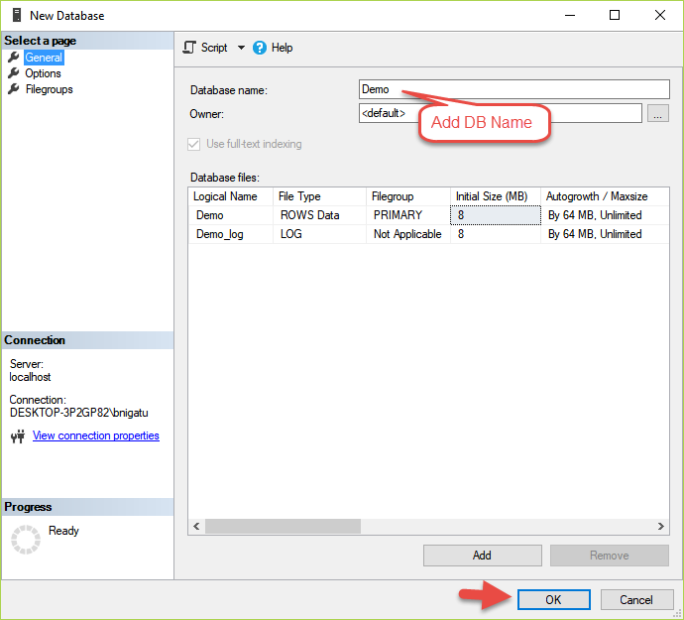
Create a Database In MS SSMS
Open SSMS
For the “Server name” use you machine name or simply “localhost”

Slide 9
References
Hernandez, M. J. (2013). Database design for mere mortals: a hands-on guide to relational database design. Pearson Education.
Merriam-Webster (2018). Database. Retrieved from https://www.merriam-webster.com/dictionary/database

